Slide 1
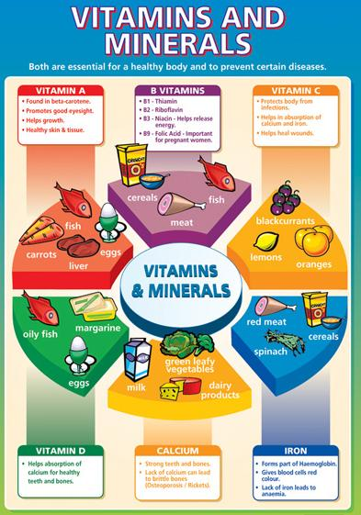
Vitamins and Minerals
Chapter 18

Slide 2
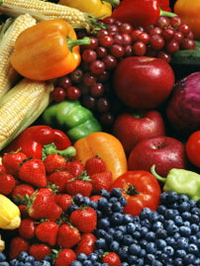
Vitamins
Definition - Complex organic substances vital for life.
Function – Combines with enzymes to help chemical reactions take place.
Megadoses – excessively large amounts of vitamins

Slide 3
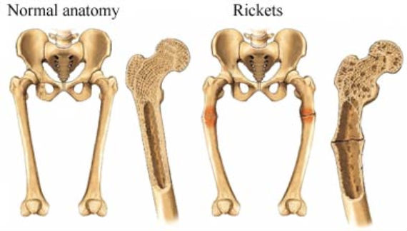
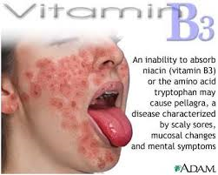
Vitamin deficiencies
Deficiency Disease – a disease caused by a lack of a specific nutrient
Beriberi – a disease of the nervous system that causes partial paralysis, weakness, mental confusion, and death. Caused by lack of vitamin B1, or thiamine.
Osteomalacia – Adult Rickets (lack of vitamin D)
Pellagra – a disease that causes skin eruption, digestive and nervous disturbances, and eventual mental decline

Slide 4
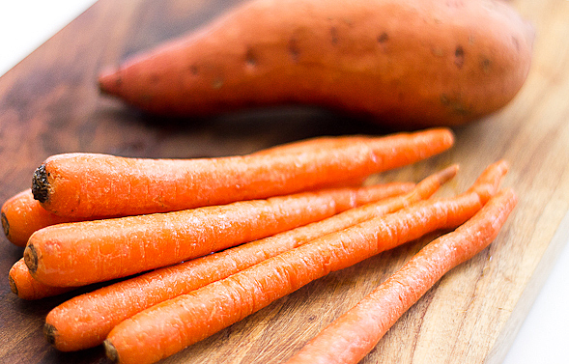
Vitamin Precursor
Precursor is a compound that can be changed into a vitamin in the body. Vitamin precursors are also called pro-vitamins.
Beta carotene, is an orange plant pigment that can be changed into vitamin A in the intestines and liver.

Slide 5
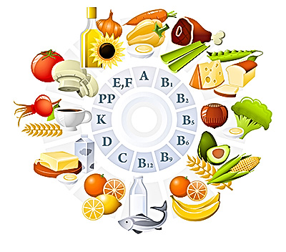
Two Categories of vitamins
Water Soluble-dissolve in water
Fat soluble-dissolve in lipids
Thiamin, (vitamin B1)
Riboflavin, (vitamin B2)
Niacin
Vitamin B6
Vitamin B12
Folacin
Pantothenic acid
Biotin
Vitamin C
Vitamin A
Vitamin D
Vitamin E
Vitamin K

Slide 6
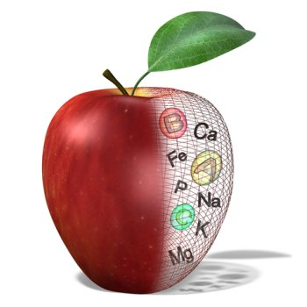
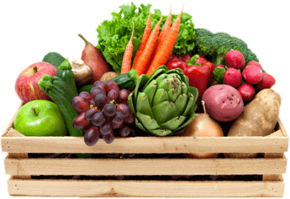
Minerals
Definition – inorganic elements needed by the body.
Function – help chemical reactions in the body. Often working as a team with vitamins. For example, vitamin C boosts iron absorption, and zinc helps the liver release vitamin A.

Slide 7
Two Classes of Minerals
Major minerals-needed in amounts of 0.1g or more daily.
Trace minerals- body needs 0.01g or less
Sodium
Potassium
Calcium
Phosphorus
Chloride
Sulfur
Magnesium
Iron
Iodine
Zinc
Copper
Manganese
Fluoride
Chromium
Selenium
Molybdenum

Slide 8
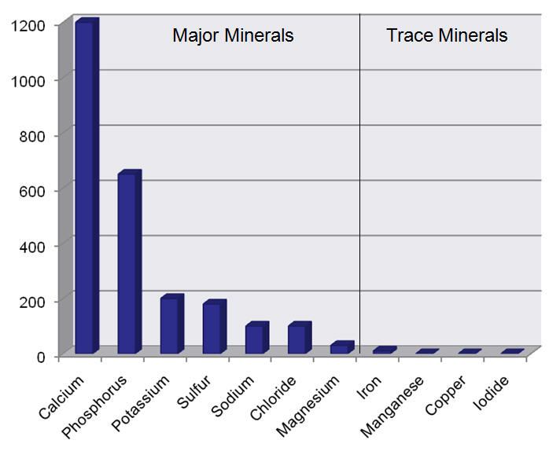

Slide 9
Phytochemicals in f0ods
Phytochemicals - Compounds that come from plant sources and may help improve health and reduce the risk of some diseases.
Food Sources | Phytochemical | Possible Link to Health
Garlic, onions, leeks, chives | Allyl sulfides | May trigger enzyme production to help eliminate carcinogens (cancer causers)
Fruits, and vegetables with deep pigments, such as carrots, pumpkin and spinach | Carotenoids such as beta carotene and lycopene | Antioxidants; may reduce cancer risks
Grapes | Ellagic acid | May reduce risk of heart disease
Broccoli, cauliflower, cabbage, and other cruciferous vegetables | Indoles Sulforaphane | May reduce risk of breast cancer May play a role in cancer prevention
Soy and legumes | Isoflavones | May reduce risk of some cancers May lower cholesterol
Flaxseed | Lignans | May reduce risk of breast and ovarian cancers

